Slide 1
To-do list app
Wireframe
Zachary Lineman

Slide 2
What is the point?
My app is made to help people become more organized. It allows for users to add notes and due dates to their tasks or to-do’s that they need to complete.

Slide 3
Wireframe

Slide 4
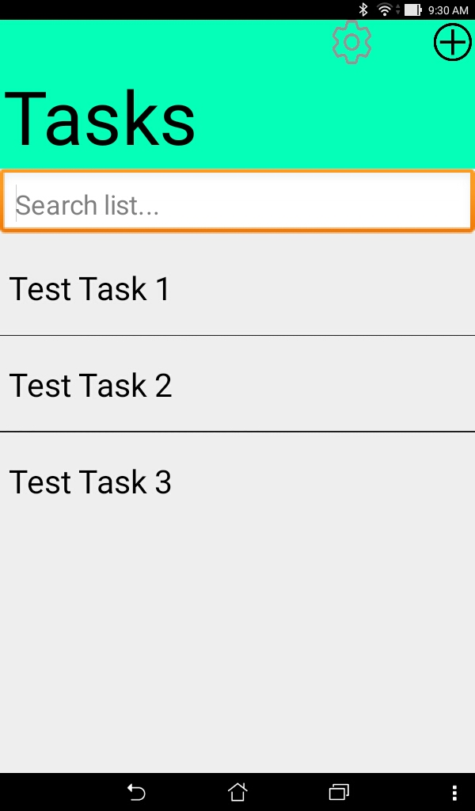
Screen 1a
This is the first screen. It will use a list view that contains the different tasks the user has added. In the top right there are two buttons, the one on the right jumps to screen 1b and the one on the left jumps to screen 3a.

Slide 5
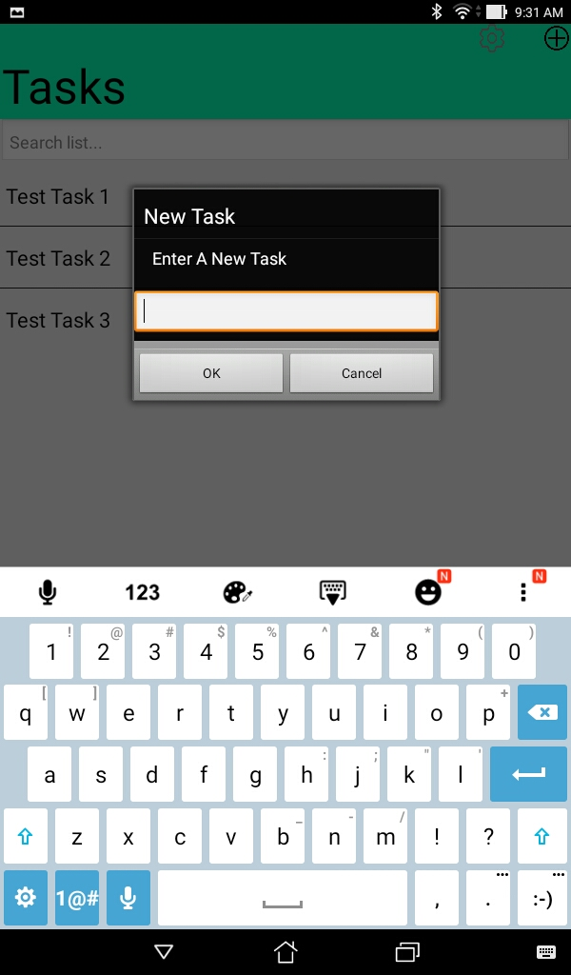
Screen 1b
This is screen 1b it is just a text box that appears over screen 1a. The point of this text box is to prompt the user to input the name of the task they want to add. When ok is clicked it will send the user to screen 2 and save the name of the task in the list. When canceled it will send the user to screen 1a.

Slide 6
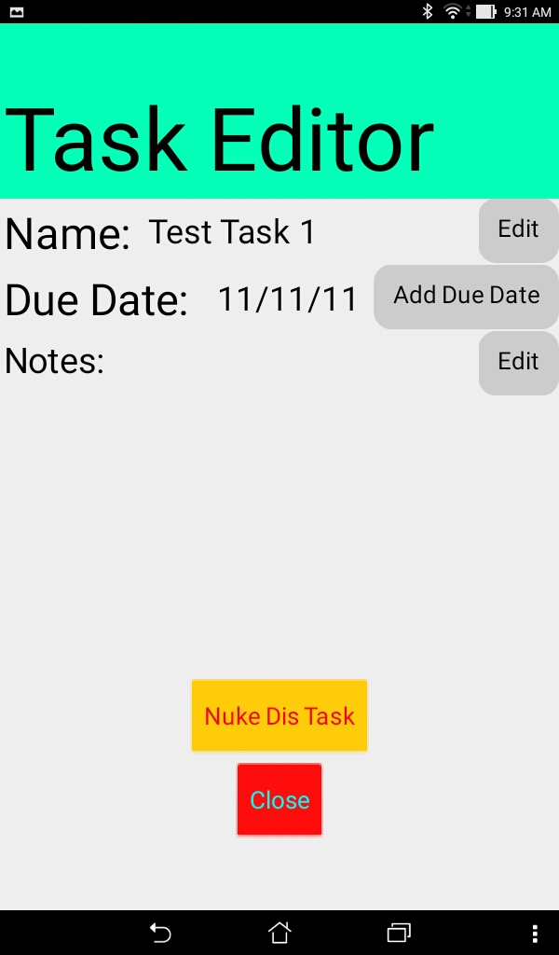
Screen 2a
Send the user to screen 2b
Screen 2 is the task editor screen. It will allow the user to edit, the task name, the due date, and the notes. It will also allow the user to delete the task.
Send the user to screen 2c
Send the user to screen 2d
Will delete the task
Send the user to screen 1a

Slide 7
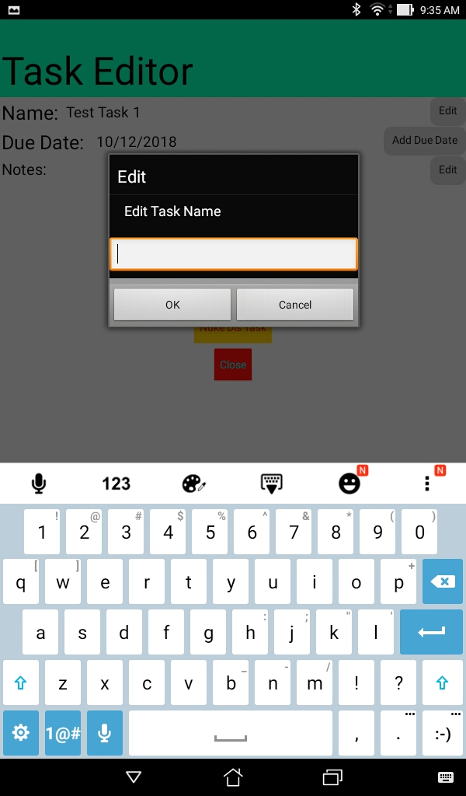
Screen 2b
Sceen 2b is just a popup over 2a that allows the user to change the task name.

Slide 8
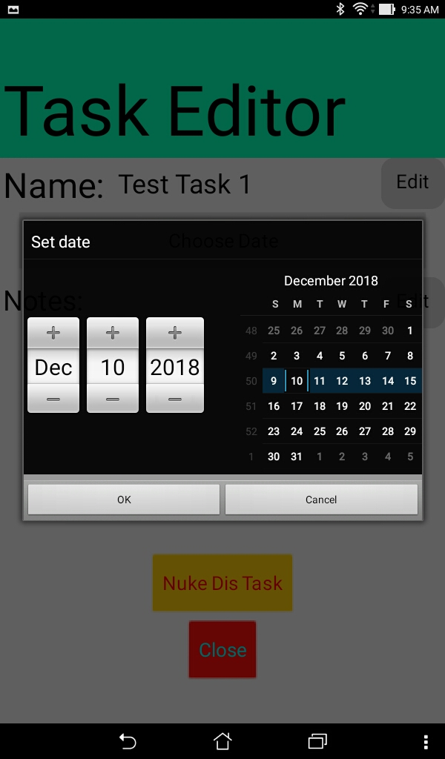
Screen 2c
Screen 2c allows the user to pick the due date for their task. An alarm will be given to the user on this specified date.

Slide 9
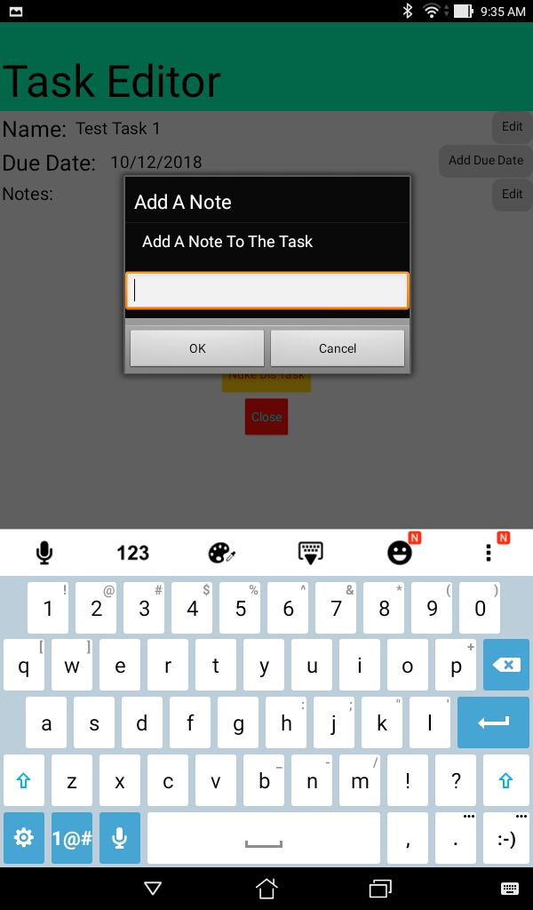
Screen 2d
Screen 2d is a popup over screen 2a. It prompts the user to input a not for their specified task. This note will be stored for the user and will be available after the app is closed and opened.

Slide 10
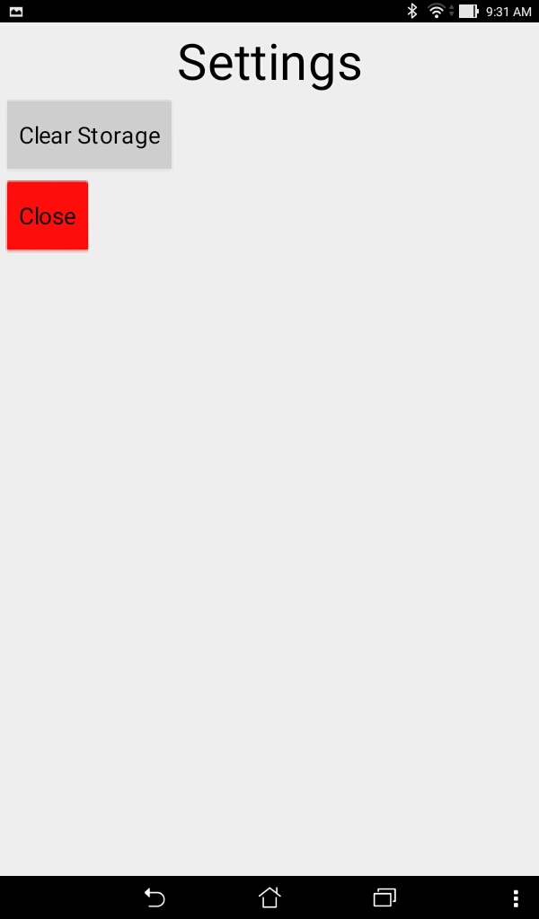
Screen 3a
Screen 3a is just a settings tab that allows the user to reset their storage and all the variables stored.

Slide 11
Code to be implemented

Slide 12
Lists

Slide 13

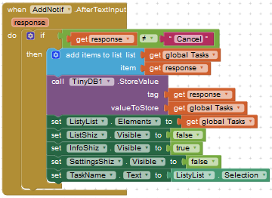
Lists - Makes my life easier.
This code initializes a variable and will be used to store the users tasks.
This code stores the responses from the user into the Tasks variable.

Slide 14
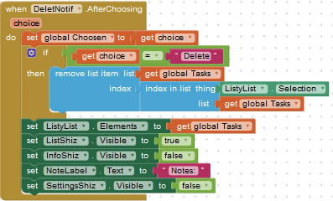
Lists - Makes my life easier.
This code is used to delete tasks from the list.

Slide 15
Switching Screens

Slide 16
Switching Screen substitute.
One problem I have with app inventor is it’s inability to correctly or easily pass data between screens. I fixed this problem by using one screen and dynamically hiding and unhiding different views which allows for much more control over the UI.

Slide 17
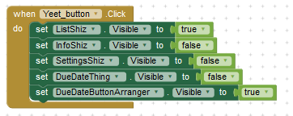

Example Code:
This code hides and unhides screens when a button is clicked
These are all the horizontal arrangements present in my code. They contain my entire UI.

Slide 18
All Current Code

Slide 19
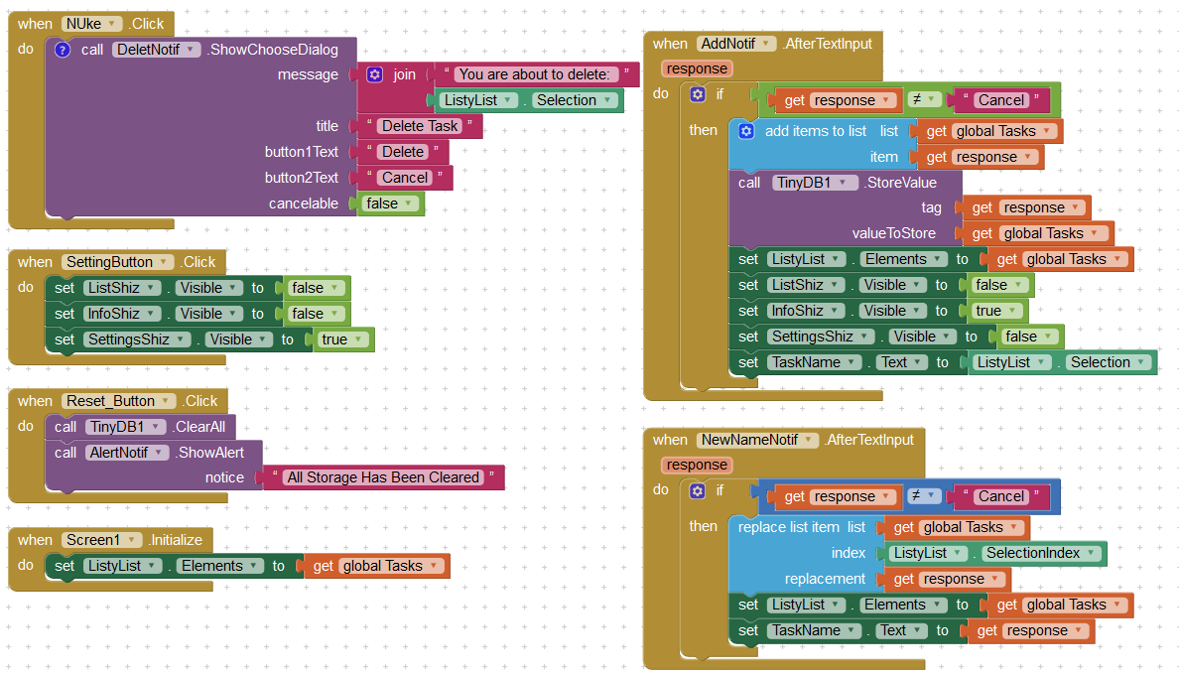

Slide 20
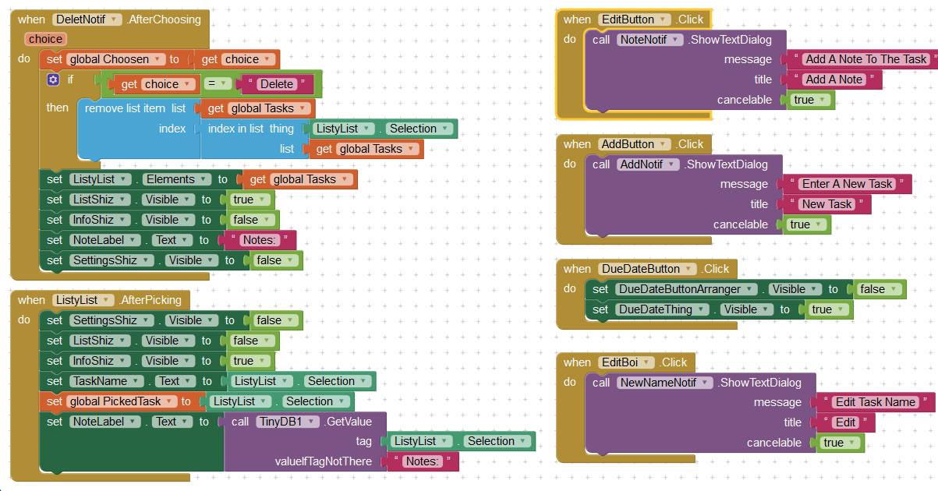

Slide 21
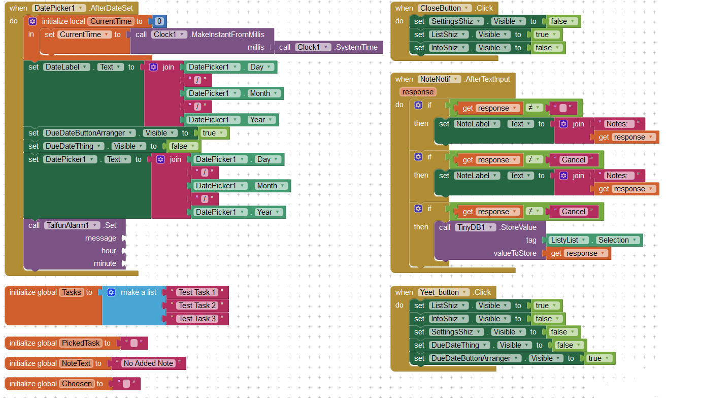

Slide 22
Done

